Slide 1

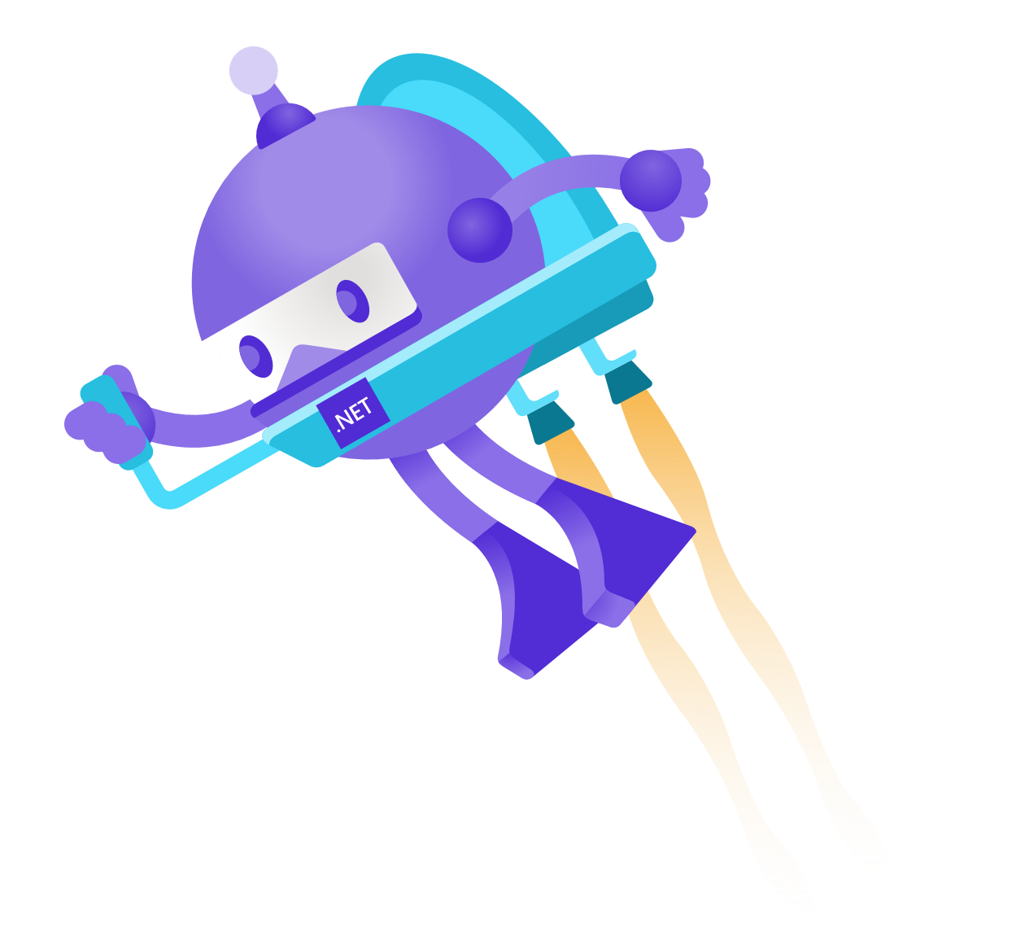
Secure DevOps with the Microsoft identity platform
Christos Matskas @ChristosMatskas
John Patrick Dandison @AzureAndChill

Slide 2


You’re invited to learn from industry experts inside & outside of Microsoft. Interactive, informal & engaging format. https://aka.ms/425show Mondays. Fridays. 8APT 11AET 4PUK 5PCET

Slide 3

Come as you are
Bring your own developer tools, services & platforms
Notes:
Photo: File:Kurt Cobain 1991 cropped.jpg - Wikimedia Commons

Slide 4




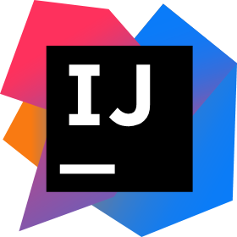
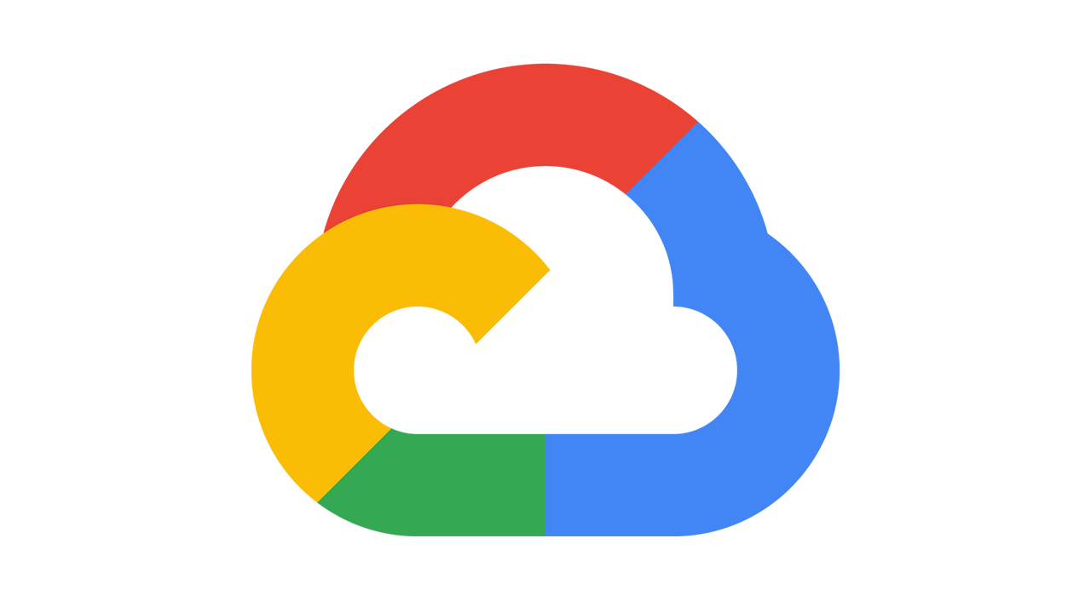






Bring your own developer tools, services and platforms
Identity
Any cloud
Any language
Bitbucket
Serverless
Amazon Web Services
Java
IntelliJ IDEA
Kubernetes
Google Cloud Platform
Python
PyCharm
Bare metal
DigitalOcean
Javascript
…or on-prem
and many more…
Notes:
Every company wants to digitally transform and we see organizations reaping real, tangible benefits - the positive outcomes are truly amazing.
One group of people that is a catalyst for digital transformation are developers. Developers are the builders of our era, creating the ideas and writing the code that enables digital transformation for organizations around the world. They are at the heart of innovation.
It’s why the Microsoft identity platform is woven into the tools, service and platform developer use today. From IDEs like Visual Studio, to popular Azure services like App Service, Functions or Kubernetes to low code solution like power apps, the Microsoft identity platform is integrated into the workflows of these services.
We want to enable any developer to easily get started with the Microsoft identity platform using the tools and services they know and love.

Slide 5




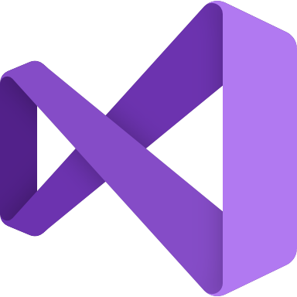


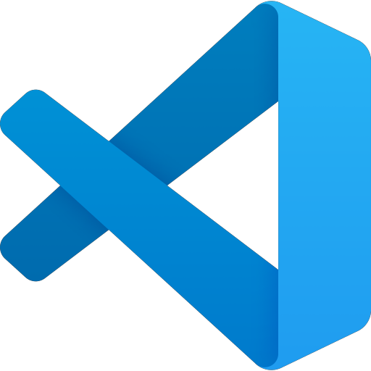


Integrated with Microsoft’s developer ecosystem
Identity
Microsoft 365 platform
Azure services
GitHub
Power Automate
Teams
App Service
Visual Studio
Power Apps
SharePoint
Azure Kubernetes Service
Visual Studio Code
Power Virtual Agents
Exchange
Functions
…
…
Notes:
Every company wants to digitally transform and we see organizations reaping real, tangible benefits - the positive outcomes are truly amazing.
One group of people that is a catalyst for digital transformation are developers. Developers are the builders of our era, creating the ideas and writing the code that enables digital transformation for organizations around the world. They are at the heart of innovation.
It’s why the Microsoft identity platform is woven into the tools, service and platform developer use today. From IDEs like Visual Studio, to popular Azure services like App Service, Functions or Kubernetes to low code solution like power apps, the Microsoft identity platform is integrated into the workflows of these services.
We want to enable any developer to easily get started with the Microsoft identity platform using the tools and services they know and love.

Slide 6
Secretless apps with .NET and Azure Key Vault
Christos

Slide 7
Secure GitHub Actions with ARM and Azure Key Vault
Christos

Slide 8
Secure GitHub Actions with Managed Identies and custom agents
John Patrick

Slide 9
Managed Identities outside Azure? YES
John Patrick

Slide 10
You’re invited to learn from industry experts inside & outside of Microsoft. Interactive, informal & engaging format. https://aka.ms/425show Mondays. Fridays. 8APT 11AET 4PUK 5PCET

Slide 11

Thanks for joining!

